Slide 1
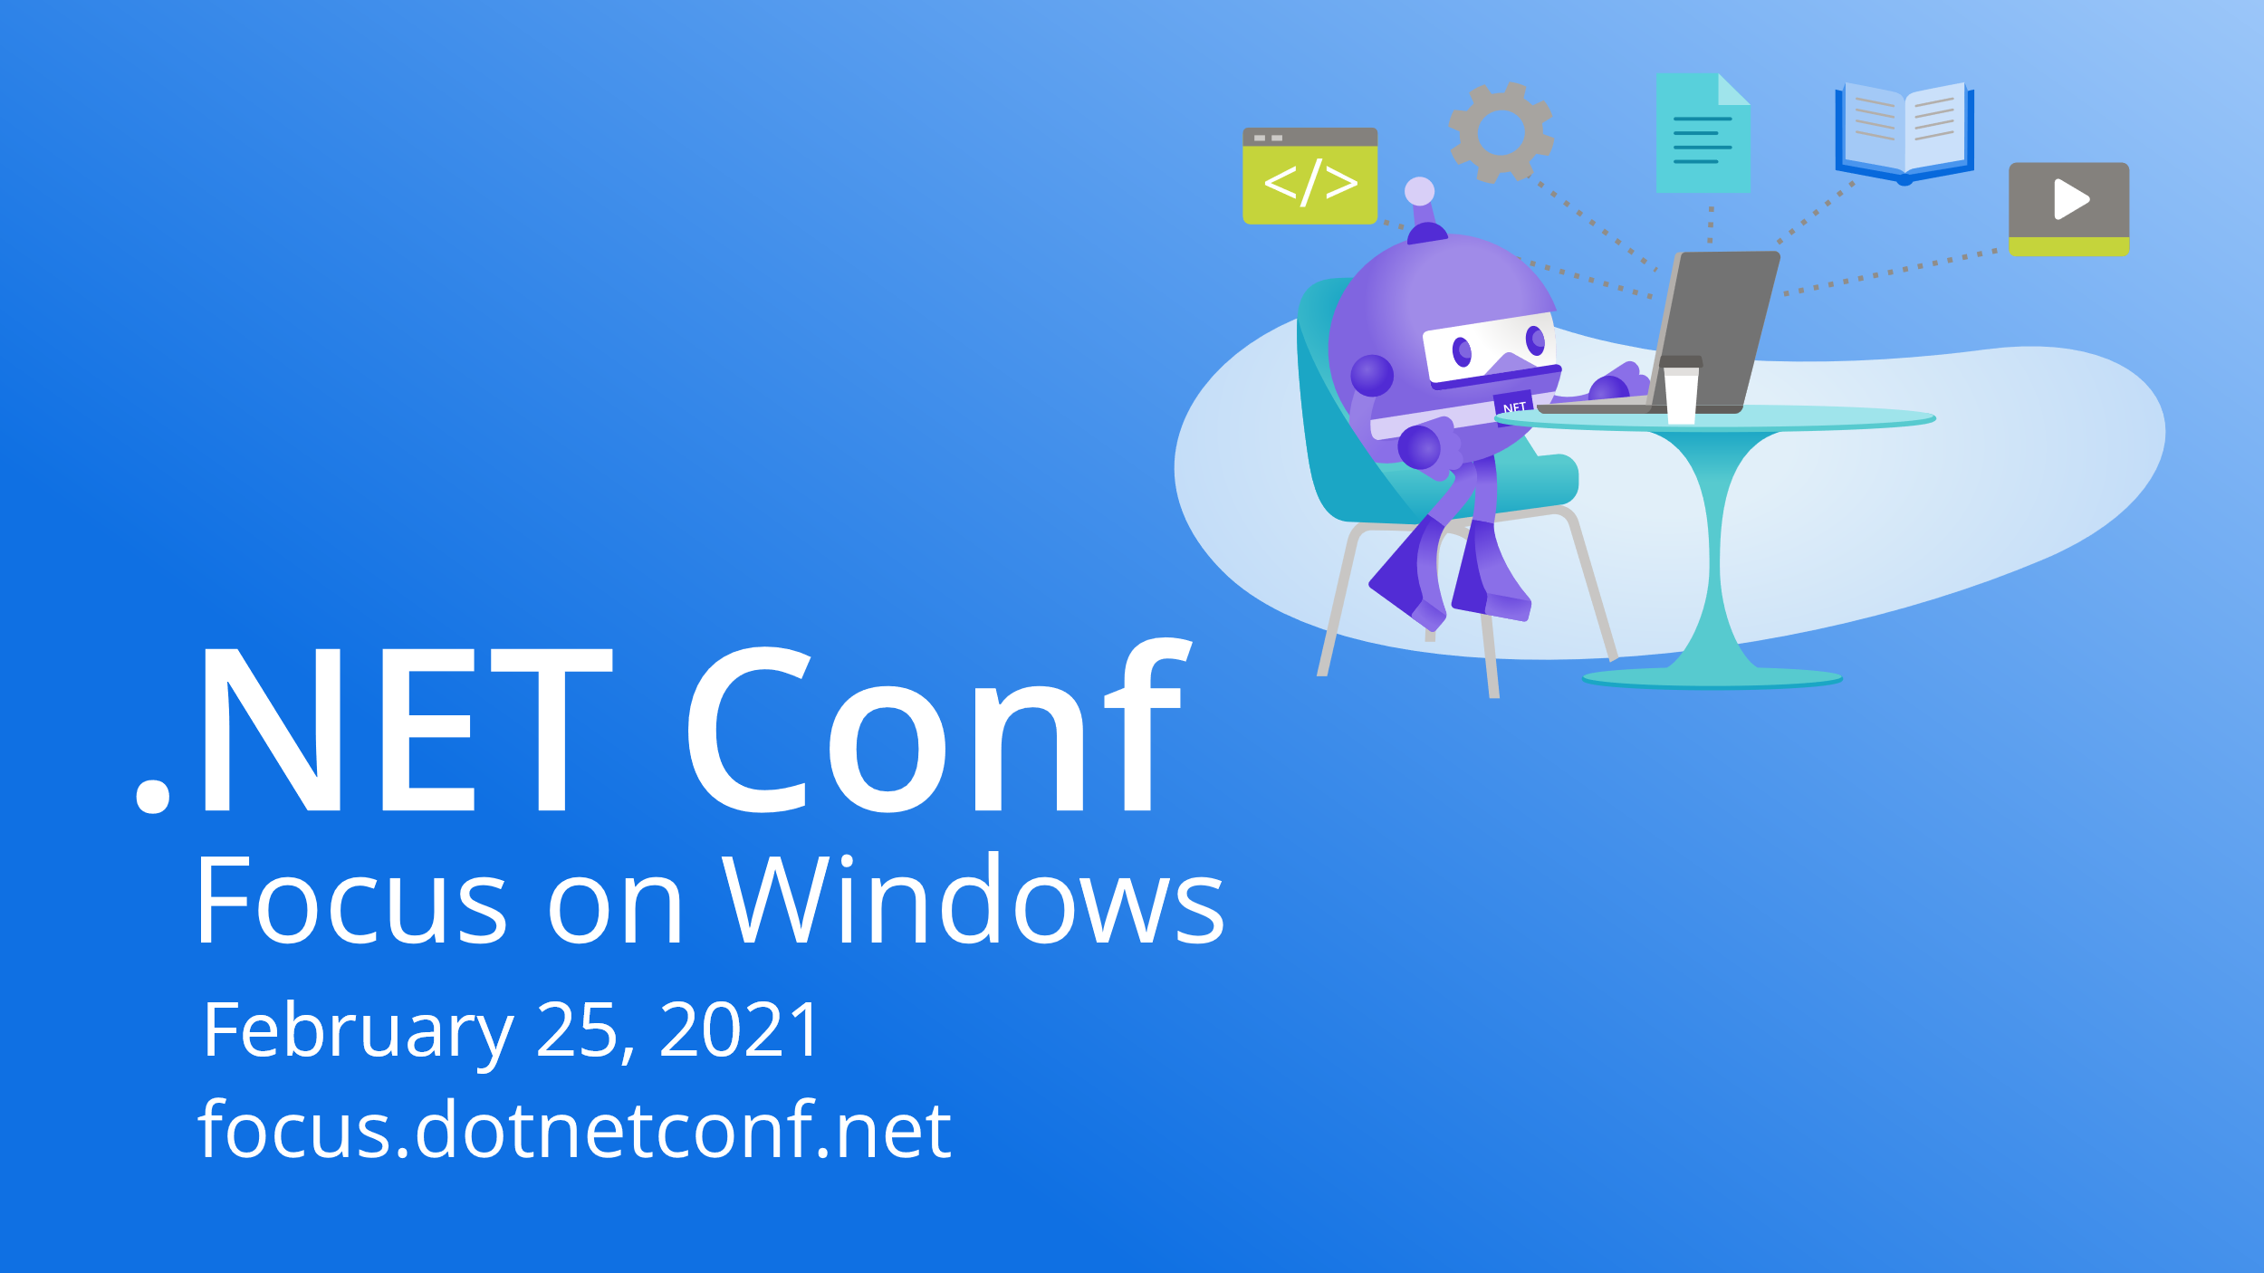

Slide 2






An Opinionated Way to Deploy Windows Apps using GitHub Actions
Isaac Levin
Senior Product Marketing Manager
@isaacrlevin

Slide 3


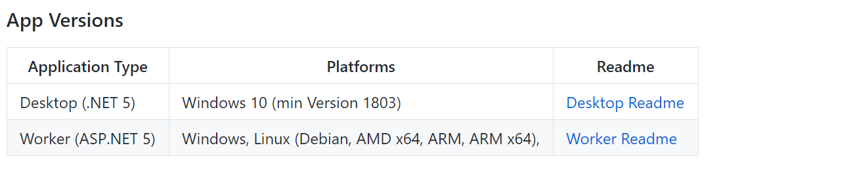
Shipping Desktop Apps… A STORY
Full GitHub Action Enabled CI/CD

Slide 4
Commit to App Channels with GitHub Actions
Configurable Build Environments per Release Channel
Chaining workflows sequentially (build → code signing → deploy)
Gated Approval for certain workloads (Deploy to MS Store)
Configuration is stored in the repo for all to see
All build/deploy logs accessible via GitHub Web Portal

Slide 5





Why did I do this?
Ease to deploy changes
Approval workflows for certain scenarios
Automated build/sign/deploy
Multiple Channels to Deploy To
Windows Store
Chocolatey
GitHub Releases
Others in the future (win get)

Slide 6
Lets take a Look!

Slide 7
Presence Light v 4.0 Announcement
Custom Light Color Configuration
Choose between Teams Availability OR Activity
Additional Light Support
Remote Phillips Hue
Phillips Wiz
More Robust Logging
https://isaacl.dev/presencelight

Slide 8

Thanks for joining!
https://isaacl.dev/presencelight
Ask your questions live on Twitter #dotNETConf

Slide 9









Slide 10








Slide 11









Slide 12


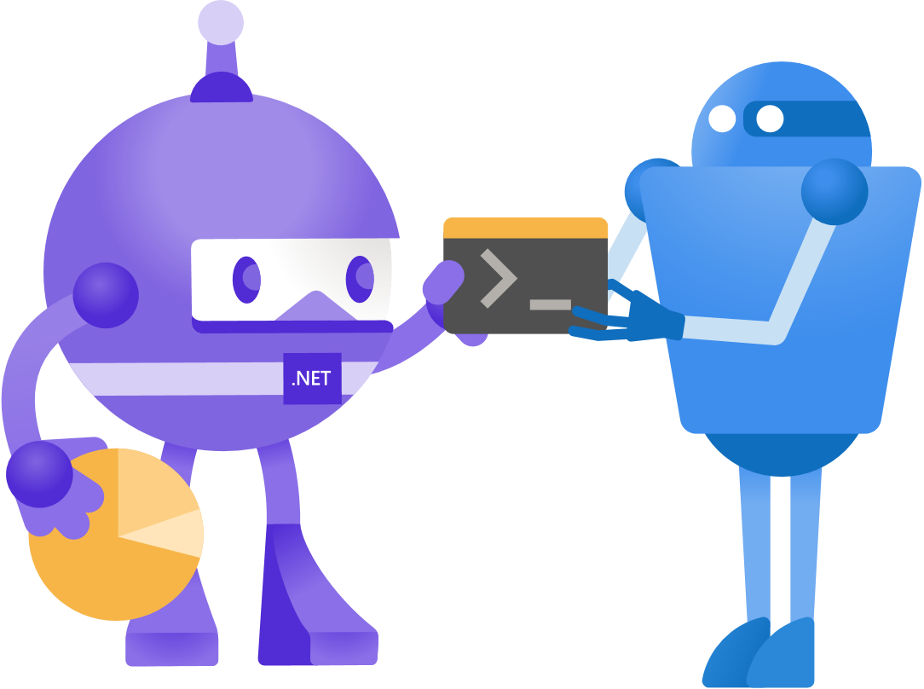


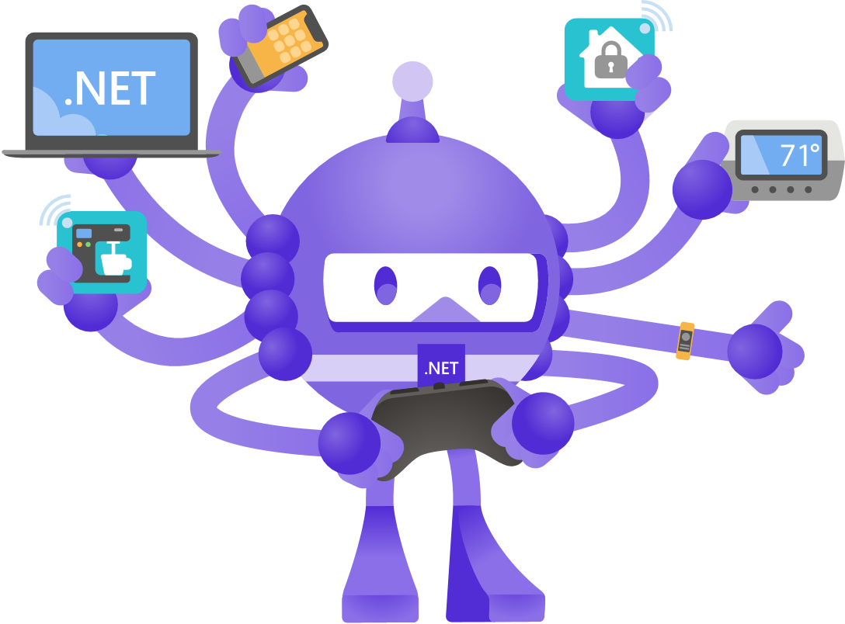



Slide 13





Slide 14


Slide 15


Slide 16


Slide 17


Slide 18


